Slide 1
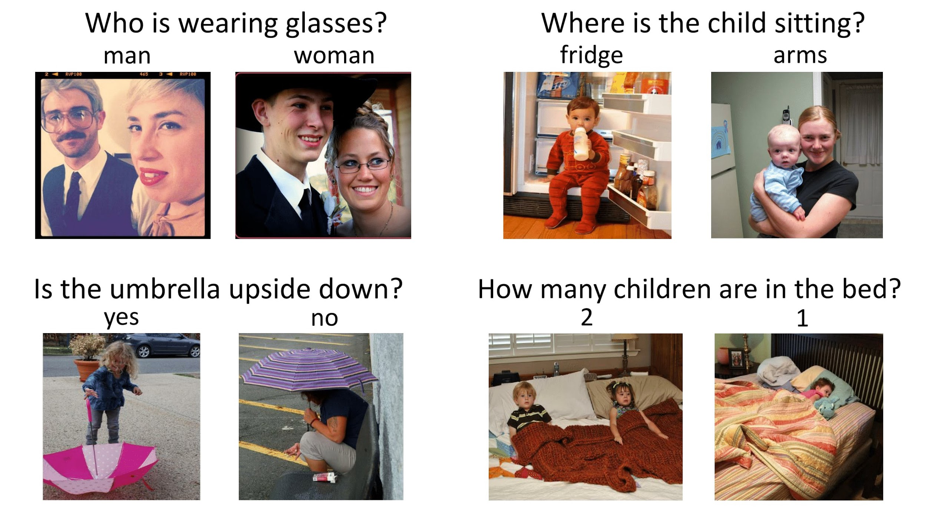
Visual Question Answering System
CLIQUE INTERESTSHIP 1.0
ML-T3
Devshree Patel
Yesha Shastri

Slide 2
Walkthrough
Explored EASY-VQA dataset and implemented it. [Source: https://victorzhou.com/blog/easy-vqa/ ]
Tinkered with CloudCV VQA demo. [Source: http://vqa.cloudcv.org/ ]
Went through : “A Convolutional Neural Network Based Approach For Visual Question Answering” for proper understanding of different models and their usage in VQA domain.
[Source: https://core.ac.uk/download/pdf/159401045.pdf ]
Implemented VQA with Bag Of Words approach with VGG Model.
Implemented VQA with LSTM.
Tried to work with “Hierarchical Question-Image Co-Attention for Visual Question Answering”.

Slide 3
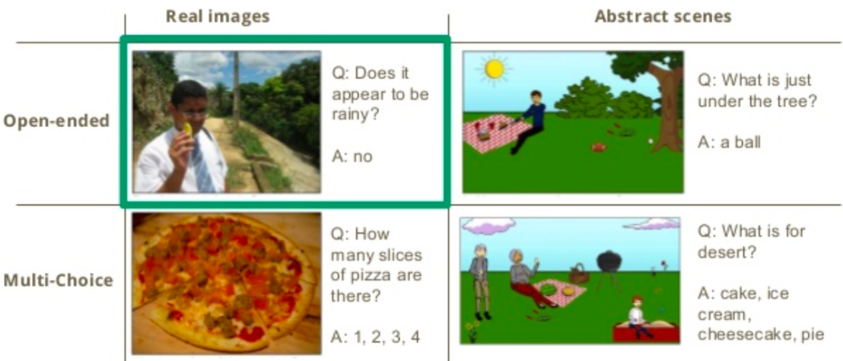
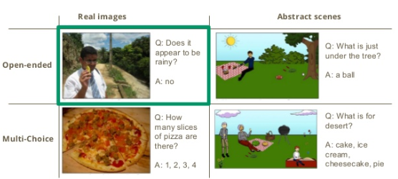
Visual Question-Answering: Types

Slide 4
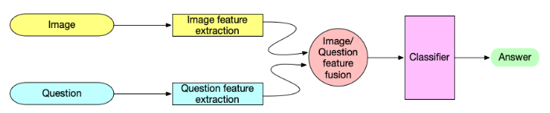
Building Blocks of the System
There are three main steps involved :
Feature extraction - This block is used to extract relevant features from the input image and question separately.
Feature fusion - This block takes both features and provides a fused multi-modal feature as output.
Classifier - This block takes the fused feature vector as input and classifies it into answer labels.

Slide 5
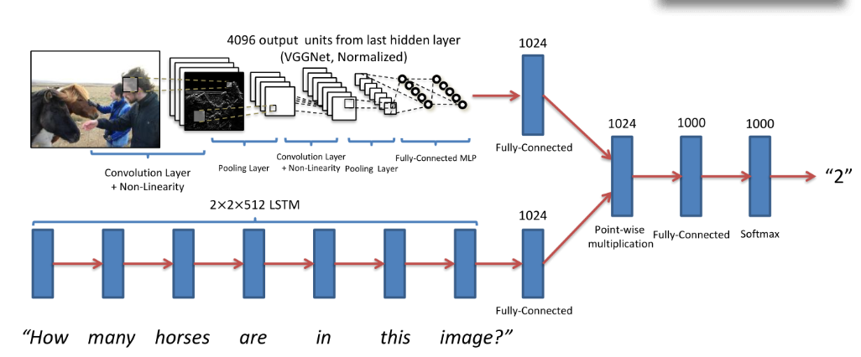
Feature extraction models

Slide 6
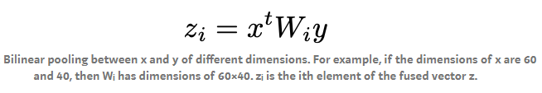
Feature Fusion Methods
Element-wise multiplication of image feature vectors and question feature vectors
Disadvantage: Cannot fuse feature vectors from different dimensions
Bilinear Pooling :
Other methods : concatenation, attention-based pooling, Bayesian-based methods and compositional approaches

Slide 7
About Baseline Models
Baseline models gauge the complexity of a dataset.
For VQA , guessing the answers with high frequencies or guessing randomly are the simplest baseline models.
One of the most used baseline approach is applying either a nonlinear or a linear multi-layer perceptron (MLP) to the vector that is formed by fusing the question and image features.
Some of the methods to combine the question and image features are element-wise multiplication, element-wise addition and concatenation.
It is proved that when question features were represented using BOW and image features were represented using CNN features from GoogLeNet it performed much better than the previous baseline model for COCO-VQA, which used an LSTM for question features.

Slide 8
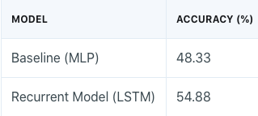
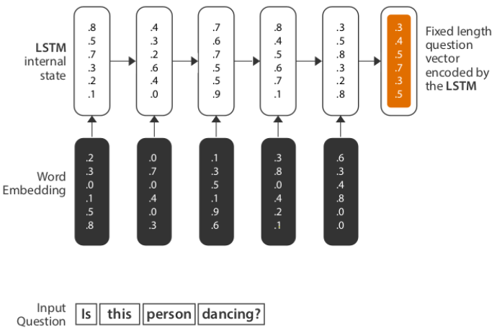
MLP vs LSTM results on COCO VQA
The results depict that memory based models are more efficient in comparison to Baseline Models involving Multi Layer Perceptron.
In a Recurrent Model, the sequence of words is preserved. This nature of preserving long sequences is what makes RNNs perfect for NLP related tasks.
We choose to go ahead with LSTMs to avoid a fundamental limitations of vanilla RNNs: the Vanishing Gradient Problem.

Slide 9
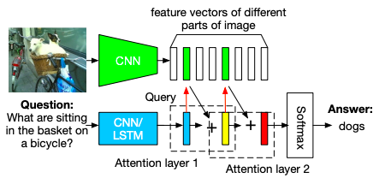
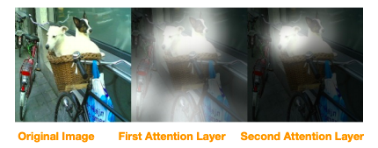
Attention Based Models in VQA
Stacked Attention Networks(SANs) use semantic representation of a question as query to search for the regions in an image that are related to the answer.
The SAN first uses the question vector to query the image vectors in the first visual attention layer, then combine the question vector and the retrieved image vectors to form a refined query vector to query the image vectors again in the second attention layer.
The higher-level attention layer gives a sharper attention distribution focusing on the regions that are more relevant to the answer.
Finally, we combine the image features from the highest attention layer with the last query vector to predict the answer.

Slide 10
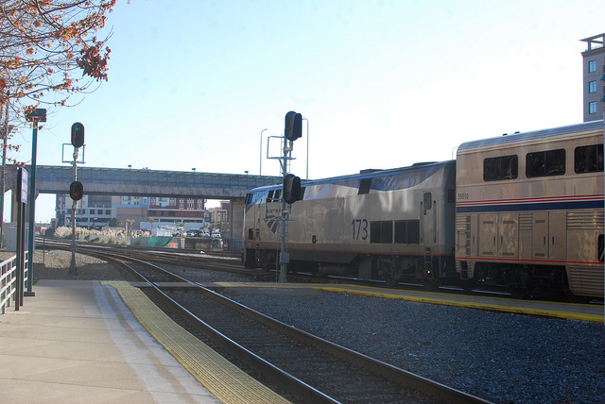
Results
Q: What vehicle is in the picture?
Answer:
78.32 % train
01.11 % truck
00.98 % passenger
00.95 % fire truck
00.68 % bus

Slide 11
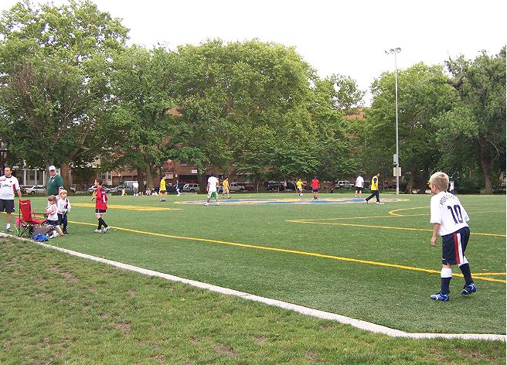
Results
Q: What are they playing?
Answer:
40.52 % tennis
28.45 % soccer
17.88 % baseball
11.67 % frisbee
00.15 % football

Slide 12
THANK YOU!

